Slide 1

2018-2019 Executive Risk
Pre-Renewal Discussion
July 6, 2018

Slide 2
EXECUTIVE RISK PROGRAM
MEETING AGENDA
Introduction to SORM and Gallagher Service Teams
Brief Overview of the D&O Insurance Program
  What Programs Make Up the SORM Executive Risk Program?
  What Planned Changes are Expected for SORM?
Market Conditions
Update on the Renewal Process
  New Products to Consider for 2018 (Cyber Stand-alone, Fiduciary, Crime)
  2018 Renewal Expectations and Timing
Open Discussion
  Current program
  Coverages
  Options / enhancements
Questions and Answers

Slide 3
Service Team
EXECUTIVE RISK PROGRAM
Name/Title | Phone | E-mail
SORM Primary Contacts
Jacqueline Baynard Senior Insurance Manager State of Texas Office of Risk Management | 512-936-1555 (Ph – Direct) 512-370-9084 (Fax) | Jacqueline.Baynard@sorm.texas.gov
Danica Dickson Insurance Manager State of Texas Office of Risk Management | 512-936-1483 (Ph – Direct) 512-370-9064 (Fax) | Danica.Dickson@sorm.texas.gov
Derrick Guzman Insurance Manager State of Texas Office of Risk Management | 512-936-2927 (Ph – Direct) 512-370-9199 (Fax) | Derrick.Guzman@sorm.texas.gov
Arthur J. Gallagher & Co. Service Contacts
Paul D. Pousson, ARM Area Senior Vice President Arthur J. Gallagher Risk Management Services, Inc. | 512-652-2443 (Ph – Direct) 512-844-8087 (Ph – Cell) | Paul_Pousson@ajg.com
Dr. Phil Norton, PhD Vice Chairman, Midwest Region Arthur J. Gallagher Risk Management Services, Inc. | 312-803-7429 (Ph – Direct) 630-561-2541 (Ph – Cell) 312-803-6343 (Fax) | Phil_Norton@ajg.com
Stephen R. Fitzsimonds Area Sr. Vice President Arthur J. Gallagher Risk Management Services, Inc. | 312-803-7425 (Ph – Direct) 847-867-8949 (Ph – Cell) 312-803-6343 (Fax) | Steve_Fitzsimonds@ajg.com
Natalie Douglass, Esq. Area Vice President Arthur J. Gallagher Risk Management Services, Inc. | 314-800-2283 (Ph – Direct) 314-954-0813 (Ph – Cell) 314-965-5425 (Fax) | Natalie_Douglass@ajg.com
Cheryl Kelley, CISR Area Vice President Arthur J. Gallagher Risk Management Services, Inc. | 512-652-2461 (Ph – Direct) 972-467-7295 (Ph – Cell) 512-652-2462 (Fax) | Cheryl_Kelley@ajg.com
Paul B. Davis, Esq. Area Assistant Vice President Arthur J. Gallagher Risk Management Services, Inc. | 312-803-7451 (Ph – Direct) 303-250-6156 (Ph – Cell) 312-803-6343 (Fax) | Paul_Davis1@ajg.com
Notes:
New template for future.

Slide 4
2017-2018 CURRENT PARTICIPANTS
SORM EXECUTIVE RISK PROGRAM
Comptroller of Public Accounts
Court of Appeals – Fifth
Court of Appeals – First
Court of Appeals – Fourteenth
Court of Appeals – Fourth
Court of Appeals – Second
Court of Appeals – Seventh
Court of Criminal Appeals
Credit Union Department
Midwestern State University
Office of Consumer Credit Commissioner
Office of the Injured Employee Counsel
State Office of Risk Management
Stephen F. Austin State University
Teacher Retirement System of Texas
Texas Board of Architectural Examiners
Texas Board of Nursing
Texas Board of Professional Engineers
Texas Department of Banking
Texas Department of Housing & Community Affairs
Texas Department of Savings and Mortgage Lending
Texas Lottery Commission
Texas Medical Board
Texas Office of Public Insurance Counsel
Texas Prepaid Higher Education Tuition Board: Texas Guaranteed Tuition Plan
Texas School for the Blind and Visually Impaired
Texas Southern University
Texas State Board of Pharmacy
Texas State Board of Examiners of Psychologists
Texas State Board of Public Accountancy
Texas State Library & Archives Commission
Texas State Technical College
Texas Woman’s University
University of Houston System
University of North Texas System
State Office of Administrative Hearings
Notes:
New template for future.

Slide 5
WHAT’S NEW AT
To craft a successful renewal strategy tailored for you, we need to know what’s important to you, where you’ve been and where you’re headed to next. Here are some summary thoughts for your commentary.
37 Participants
In Management
Liability Program
Public Entities
And
Higher Education
Key Factors for you and your program participants include:
Financial Health
Changes in Legislation
Claims Activity
Anticipated Major Activities over the next 12-15 months
Intellectual
Property and
Cyber Extensions
2018
Outlook
D&O
EPL
Professional
Liability
~$2B
Total
Written
Premium
Expansions Possible for
Crime and
Fiduciary Liability

Slide 6
EXECUTIVE RISK PROGRAMS OFFERED BY
Directors and Officers Liability
Employment Practices Liability
Educators Legal Liability if a Higher Education Participant
Public Officials Professional Liability if you are a Public Entity Organization
Program can be expanded to also address
Network Security/Cyber Liability
Fiduciary Liability
Blanket Crime

Slide 7
COVERAGE
Directors and Officers Liability coverage is broad and addresses both individual and organizational risk exposures in the management and oversite of your entity’s operations. Forms are expanded to address trustees, managers, and employees
Employment Practices Liability addresses both State and Federal guidelines and laws, including matters surrounding retaliation, grant of tenure, harassment and discrimination (including third party claims), some wage and hour coverage and several other employment perils, many related to traditional wrongful termination matters
All programs include the SORM Mega endorsement that broadens terms beyond current insurance marketplace expectations and includes SORM’s Automatic Renewal Premium clause.
For Higher Education entities, If needed, program offer limited Intellectual Property protection to the organization

Slide 8
Premium Control
SORM’s Automatic Renewal Premium Provisions allows the participants of the program the same rate for noted coverage lines from the prior year if an organization-
Does not have an employee count change of 10% or more from the prior year
Budget for operations does not increase or decrease by more than 10% from the prior year
Is not operating in a deficit or anticipates operating in a budge deficit from the prior year
Does not have a claim during the past year that has expenses in excess of 50% of the current retention level for noted coverage line
Does not have material change in operations from the prior year. (Merger, divestiture or closure, etc.)

Slide 9
D&O Market Trends
Despite an influx of new and renewed capacity, average renewals saw a small increase in 2017 as shown in Graph 1. Increases were driven by adverse claims trends, though most renewals were flat.
Further demonstrated in Graph 2, more than half of all renewals in the 4th Quarter of 2017 were flat despite increased exposures from business expansion.
Coverage offered continues to expand with a few key carriers driving positive changes for the D&O policy form.
Overall D&O claim frequency is increasing, especially in federal courts, which is a growing exposure for Texas defendants.
D&O Renewal Price Changes

Slide 10
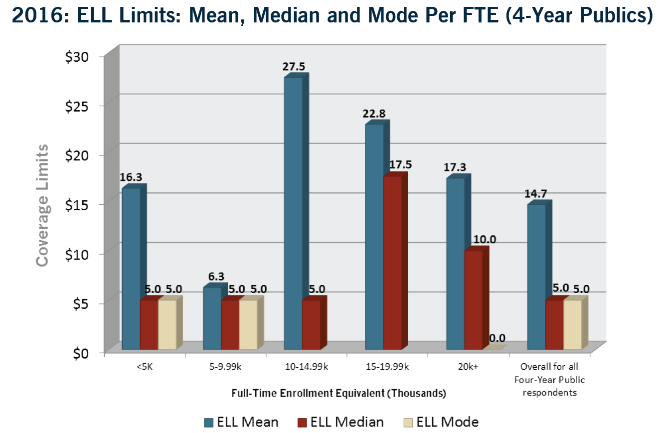
Limits Benchmarking – Educators Legal Liability FTE
These benchmarking results come from the 2016 Liability Benchmark Report created by the AJG Higher Education Practice, in which 53 public, 4-year universities were surveyed.
As might be expected, the mean limits for ELL rise as an institution gets bigger, although the lower median for large schools indicates many of them do not carry coverage. (This is exhibited by mode of 0 for those schools too, indicating the most common condition is for them to forego ELL coverage.)

Slide 11
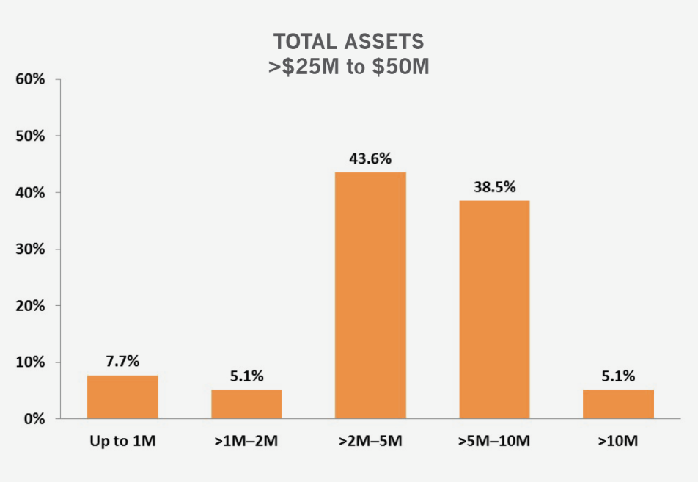
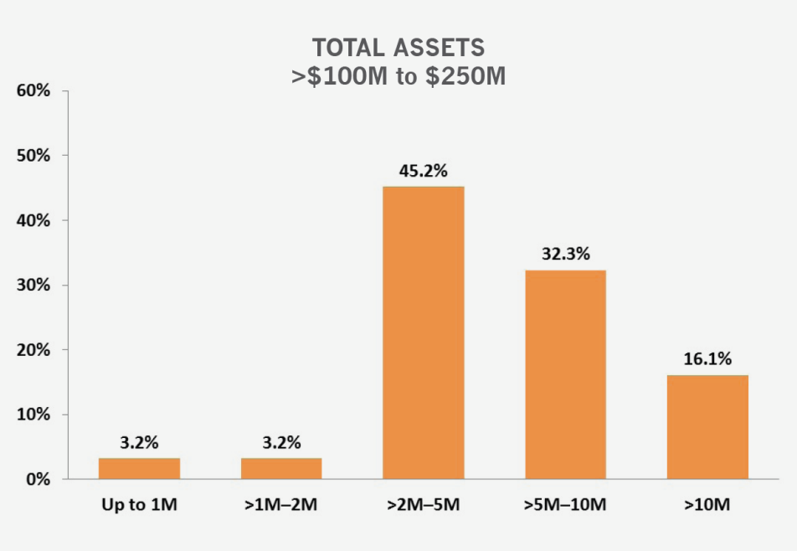
Limits Analysis for Non Profit and Public Entity Risks- Directors and Officers Liability
Source- 2017 Advisen

Slide 12
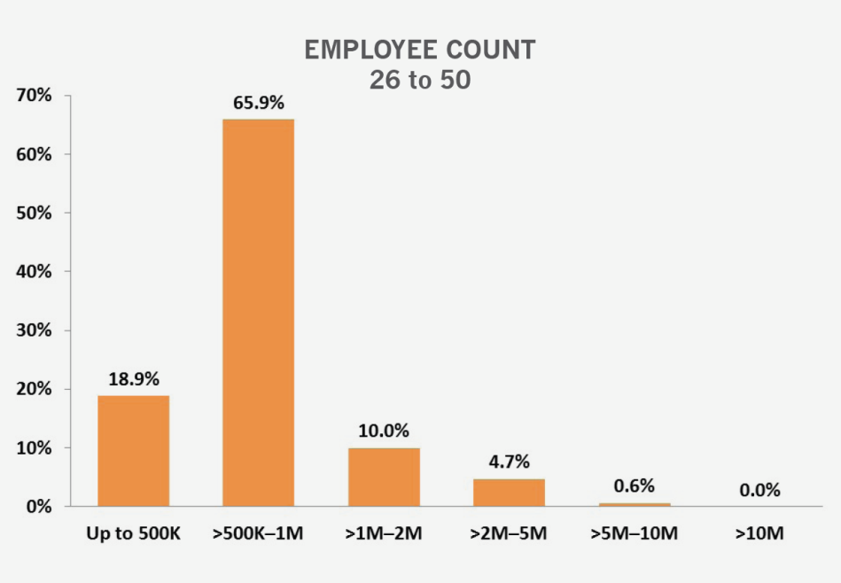
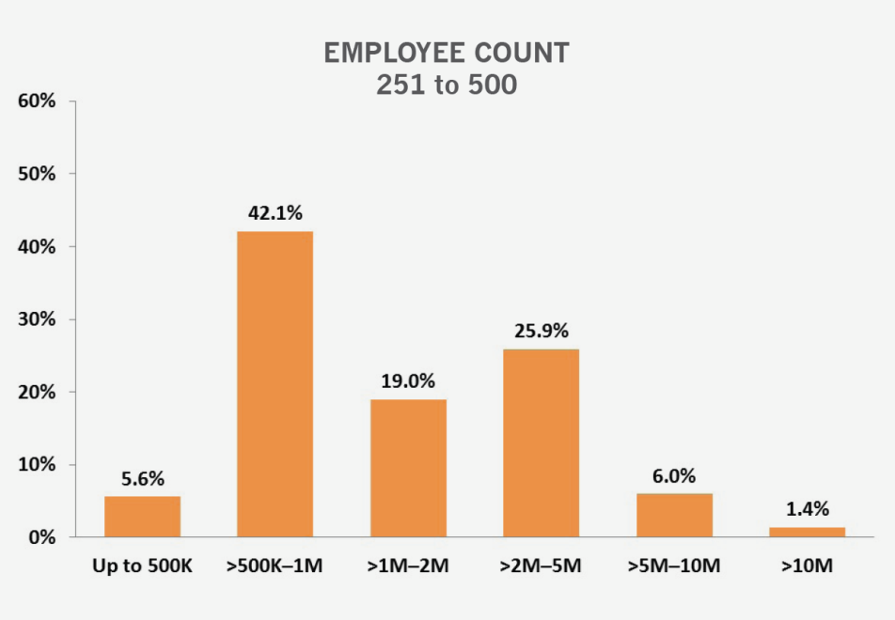
Limits Analysis for Non Profit and Public Entity Risks- Employment Practices Liability
Source- 2017 Advisen

Slide 13
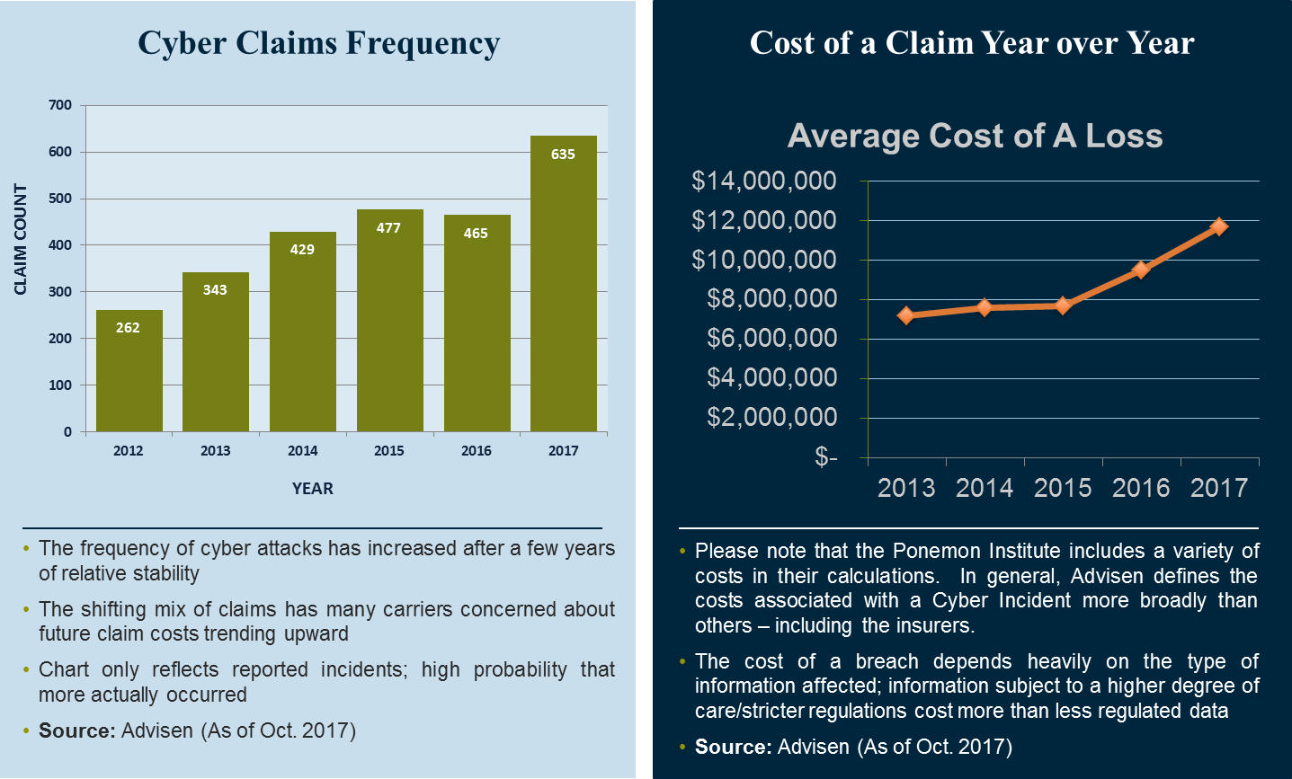
2018 Cyber Liability State of the Market
Carrier competition is at an all time high – as are claim costs. It is a perfect time for a purchase as terms and conditions are flexible and rates are still low.

Slide 14
Coverage Expansions to Be Offered
SORM EXECUTIVE RISK PROGRAM
Network Security/Cyber Liability
Two programs will be offered this year to participants.
Option #1 is a Broadened Endorsement to your D&O/EPL program using a shared limit structure
Option #2 is a stand alone program that will offer broader coverage provisions including but not limited to Multimedia Liability and enhanced Business Interruption & Extra Expense Coverages
Thus depending on your organizations need, budget, or services, SORM has a program to address your exposure. With the assistance of Gallagher and SORM, we will work with your organization to determine which product is best for you.
SORM will include in our upcoming renewal proposal pricing indications for the Option #1 endorsement.
Option #2 stand alone programs will need an additional Chubb application completed prior to quotation.

Slide 15
Coverage Expansions to Be Offered
SORM EXECUTIVE RISK PROGRAM
Option #1: Network Security/Cyber Endorsement
2017-2018 Chubb Endorsement Expansions |  | Limits
Network Security Liability |  | $1,000,000
Privacy Liability |  | $1,000,000
Media Liability |  | Not Included
Regulatory Liability |  | $250,000
PCI Assessments |  | Not Included
Breach Response Costs | Legal Expenses | $50,000
 | Notification Expense | $50,000
 | Credit /ID Monitoring | $50,000
 | Forensic Investigations | $50,000
 | Public Relations | $50,000
Cyber Extortion |  | $1,000,000
Data Recovery |  | Not Included
Business Interruption & Extra Expense |  | Not Included
Dependent Business Interruption & Extra Expense |  | Not Included
2018-2019 Chubb Endorsement Provisions |  | Limits
Network Security Liability |  | $1,000,000
Privacy Liability |  | $1,000,000
Media Liability |  | Not Included
Regulatory Liability |  | $1,000,000
PCI Assessments |  | $250,000
Breach Response Costs | Legal Expenses | $1,000,000
 | Notification Expense | $1,000,000
 | Credit /ID Monitoring | $1,000,000
 | Forensic Investigations | $1,000,000
 | Public Relations | $1,000,000
Cyber Extortion |  | $1,000,000
Data Recovery |  | $1,000,000
Business Interruption |  | $1,000,000
Dependent Business Interruption & Extra Expense |  | $250,000
Limit shared with Executive Risk Exposures
Industry leading Chubb base form operates as policy language
Estimated Cost to add: 15% additional premium or $1,500 whichever is greater
System Failure Coverage may be added for an additional premium subject to a supplemental questionnaire; this coverage triggers Business Interruption & Extra Expense
A $3,000,000 limit may be also be available upon request

Slide 16
Coverage Expansions to Be Offered
SORM EXECUTIVE RISK PROGRAM
Option #2: Network Security/Cyber Stand Alone Program
2018-2019 Chubb Endorsement Provisions |  | Limits
Network Security Liability |  | $1,000,000
Privacy Liability |  | $1,000,000
Media Liability |  | Not Included
Regulatory Liability |  | $1,000,000
PCI Assessments |  | $250,000
Breach Response Costs | Legal Expenses | $1,000,000
 | Notification Expense | $1,000,000
 | Credit /ID Monitoring | $1,000,000
 | Forensic Investigations | $1,000,000
 | Public Relations | $1,000,000
Cyber Extortion |  | $1,000,000
Data Recovery |  | $1,000,000
Business Interruption |  | $1,000,000
Dependent Business Interruption & Extra Expense |  | $250,000
2018-2019 Chubb Stand Alone Program |  | Limits
Network Security Liability |  | $1,000,000
Privacy Liability |  | $1,000,000
Media Liability |  | $1,000,000
Regulatory Liability |  | $1,000,000
PCI Assessments |  | $1,000,000
Breach Response Costs | Legal Expenses | $1,000,000
 | Notification Expense | $1,000,000
 | Credit /ID Monitoring | $1,000,000
 | Forensic Investigations | $1,000,000
 | Public Relations | $1,000,000
Cyber Extortion |  | $1,000,000
Data Recovery |  | $1,000,000
Business Interruption |  | $1,000,000
Dependent Business Interruption & Extra Expense |  | $1,000,000
Dedicated Limit for Cyber Exposures
Industry leading Chubb base form operates as policy language with additional Gallagher negotiated endorsements
Estimated cost to add: 20% additional premium – compared to $1M limit Executive Risk Package pricing
System Failure trigger for Business Interruption & Extra Expense added with answers to targeted underwriting questions
A $3,000,000 limit may also be available

Slide 17
Coverage Expansions to Be Offered
SORM EXECUTIVE RISK PROGRAM
Fiduciary Liability
Program offers assistance in protecting the employee benefit plan, the plan trustees and employees, against claims alleging breach of their fiduciary duties to the plan or alleging they committed an error in the administration of the plan.
Policy offers to important benefits of defense and indemnity to the organization and plan. What does it address-
Breach of Fiduciary Duty
Administration of the Plan- Signing individuals up, offering counsel, taking of payroll to pay premium or contribution
Voluntary Compliance Programs- EPCRS, DOL’s Voluntary Correction Program, or IRS Audit Closing Agreement
Regulatory Penalties- 502i, 502L, 502C, HIPAA, Section 4975, Settlor Act, Affordable Care Act, or the Plan Protection Correction Act
If organization has exposure to pension, retirement plan, health, dental, or stock contribution plan, Fiduciary Liability coverage may be desired. Renewal proposal will include pricing indications for a $1,000,000 and $3,000,000 limit program using the organizations total plan size as a guide. Additional information and a application will be needed, if you wish to secure and include in your SORM Executive Risk Program. Chubb has offered initial limit options, but if your organization needs, higher limits will be available up to $25 million.

Slide 18
Coverage Expansions to Be Offered
SORM EXECUTIVE RISK PROGRAM
Blanket Crime
Key Coverage Points-
Employee Dishonesty
Addresses employee theft and collusion with others to take funds or property from the organization for their own benefit and gain.
Forgery and Alteration
As it notes, the changing of a formal contract or agreement for a financial gain
Inside or Outside Premise Protection
For the theft or robbery of money, securities, or property depending on the organization activities and its needs
Computer Theft
Theft of funds or securities via a computer. This could be the mis-use of transferring funds between a financial institution and the covered SORM facility, another state agency, or the open public.
Funds Transfer Fraud
Such provisions address the potential theft or taking of funds via a wire or voice initiated transfer between the covered organization and a third party.
Claim Expense
Assists in the costs incurred in determining if activity was a claim. Such would include internal payroll and accounting services.
Policy can also address Social Engineering Fraud or Misappropriation of Funds losses for a sub-limit. It also includes necessary ERISA Bond provisions, if organization has such a plan or requirement for a retirement or benefit plan.
SORM will include in our upcoming renewal proposal pricing indications to consider a $1,000,000 limit program for your organization using the organizations total asset size as guide to possible pricing. Additional information and a Chubb application will be needed if you wish to secure and include noted coverage in your SORM Executive Risk Program. Chubb has offered initial limit option of $1 million, but if organization needs higher limits due to size or structure, carrier has ability to offer limits up to $25 million.

Slide 19
PROPOSED RENEWAL TIME LINE
Activity | Target Date
Hold necessary pre-renewal discussion with SORM and participants to discuss marketplace, expectations, questions, and timetable. | July 6, 2018
Requested renewal information provided to Gallagher from SORM participants for review and use with Chubb | In Process
Underwriting submission with detailed coverage specifications delivered to Chubb for consideration and quotation. | In Process
Primary renewal terms and conditions due by Chubb for Gallagher review and finalization. | Week of July 10, 2018
Presentation of proposals to SORM participants | Week of July 30, 2018
SORM participants to advise binding instruction to SORM and Gallagher for all management liability lines proposed. | August 15, 2018
Gallagher collects and delivers underwriters’ binders and invoices to SORM. | August 30, 2018
Primary renewal policies received and reviewed by Gallagher. If acceptable, noted policies will be provided to SORM and participants. | Week of October 29, 2018

Slide 20
Why Are These Coverages Necessary?
SORM EXECUTIVE RISK PROGRAM PUBLIC ENTITY RISKS
Directors and Officers Liability and Employment Practices Liability
While the State of Texas offers some immunity under Chapters 104 and 108, D&O coverage is still recommended to each participant as –
Chapter 108 does not apply to Federal claims brought against the individual or organization
Immunity may not apply to cases brought outside of Texas by other States
Actions of willful misconduct, gross negligence or that the defendant acted in bad faith with conscious indifference or reckless disregard, could void the indemnification provisions
Chapter 108 does not apply to healthcare providers
Insurance coverage also offers additional legal assistance for-
AG denies to offer defense in cases alleging bad faith, intentional misconduct, or gross negligence
Members of group sit on outside boards for for-profit or non-for-profit organizations at the request of the organization or State that does business or activities outside the State of Texas
AG could not offer defense services as they did not have expertise or experience. Use of private sector counsel maybe needed
AG may not defend if the definition of protected parties does not include volunteers or other parties falling outside the strict definition of Chapters 104 and 108

Slide 21
Why Are These Coverages Necessary?
SORM EXECUTIVE RISK PROGRAM
Directors and Officers Liability and Employment Practices Liability
Federal Actions that may affect you-
Civil Rights Allegations
42 U.S.C. § 1983
42 U.S.C. § 1981
42 U.S.C. § 1985
Constitutional Allegations
1st Amendment (Free Speech/Retaliation, Freedom of Religion)
4th Amendment (False Arrest, Wrongful Search and Seizure)
5th Amendment (Takings Clause)
8th Amendment (Deliberate Indifference to Medical Needs)
14th Amendment (Due Process, Equal Protection)
Employment Allegations
Title VII (race, color, religion, sex, sexual harassment, national origin, retaliation)
Rehabilitation Act, Section 504 (disability)
Americans with Disabilities Act (ADA) (disability, retaliation)
Age Discrimination in Employment Act (ADEA) (age, retaliation)
Family Medical Leave Act (FMLA)
Equal Pay Act
Other Categories of Allegations
False Claims Act (Qui Tam)
Environmental (CERCLA)

Slide 22
Coverage Expansions negotiated
SORM EXECUTIVE RISK PROGRAM
Additional Enhancements offered under the SORM Programs
Clarification made to address use of Attorney General for defense and management of the claim
Board EPL protection, including Wage and Hour Defense Cost and Third Party Liability for customer and guest claims for discrimination and harassment
Broad definition of Claim to include Arbitration, Investigation, and civil and criminal proceedings
Additional individual only, or Side A protection for a $1,000,000 limit under D&O for individuals if policy limit is exhausted.
Automatic coverage for Outside Directorship Liability for non for profit boards covered individuals sit on on behalf of the organization and their position. For profits covered too, but need to be listed
Control person provisions for notification and discovery of a claim limited to CFO and or Risk Manager.
Personal Fraud and Criminal Exclusions are limited to final non-appealable adjudication provisions
Employment Practices Liability Wrongful Act is amended to add workplace bullying, or abusive or hostile work environment as part of definition
Securities coverage with carve back to protect the board and the organization in a securities claim relative to the issuance by an organization of bond debt or claims brought by bond debt holders as defined under federal, state, and local regulations
Failure or Refusal of Organization to indemnify added to insure individual is protected whether or not the State of Texas or organization does not indemnify individual
Healthcare or Education Coverage Extension to offer defense costs for governmental funding matters, donor dispute arbitration costs, and regulatory fines and penalties. EPL is expanded to address defects in peer review or tenure matters

Slide 23
Coverage Extensions negotiated
SORM EXECUTIVE RISK PROGRAM
Additional Enhancements offered under the SORM Programs
Special Event Fund coverage using a sub-limit to help in offering consultants and services relative to eight potential matters.
Under EPL, expansion for assistance and additional legal expenses relative to a Workplace Violence activity. $250,000 sub-limit
Under the EPL, expansion to address unauthorized access to employee information. Program grants an additional $100,000 in legal expenses to assist organization in managing claim.
Under the D&O, Extradition and provisions for the Foreign Corrupt Practices act are granted in form
Priority of payment provisions to insure individuals are paid first with insurance proceeds prior to organization under the D&O
Addition of protection for Higher Education entities, If needed, to offer Intellectual Property protection to organization for defense costs using a sub-limit and higher retention levels

Slide 24
QUESTION AND ANSWERS
SORM EXECUTIVE RISK PROGRAM

Slide 25
Thank you for the Partnership!
Arthur J. Gallagher Risk Management Services, Inc.
221 West 6th Street, Suite #1980
Austin, Texas 78701

